Slide 1
Identifying Disease Markers of Parkinson’s Disease
Shreya, Alex, and Thanhbinh

Slide 2



Project TAs!
Shreya
Alex
Thanhbinh
From Bay Area, California
Incoming first year at UC Berkeley (EECS)
Enjoys learning about AI in Healthcare
From Ann Arbor, MI
3rd year MSTP / Bioinformatics PhD
Studies neurogenomics & neurodegeneration
From Virginia
3rd year MSTP / Bioengineering PhD
Studies machine learning and how the brain controls speech

Slide 3
What is Parkinson’s Disease?
1.5 million cases in the US
Progressive neurodegenerative condition
Etiology: Loss of dopaminergic neurons in the substantia nigra
Symptoms: Tremors, muscle rigidity, unsteady gait, loss of automatic movement
Onset: typically diagnosed after age 55
Treatment: dopamine replacement therapy and other medications that target symptoms
Most patients develop resistance to drugs/side effects over time
No comprehensive therapy for PD

Slide 4
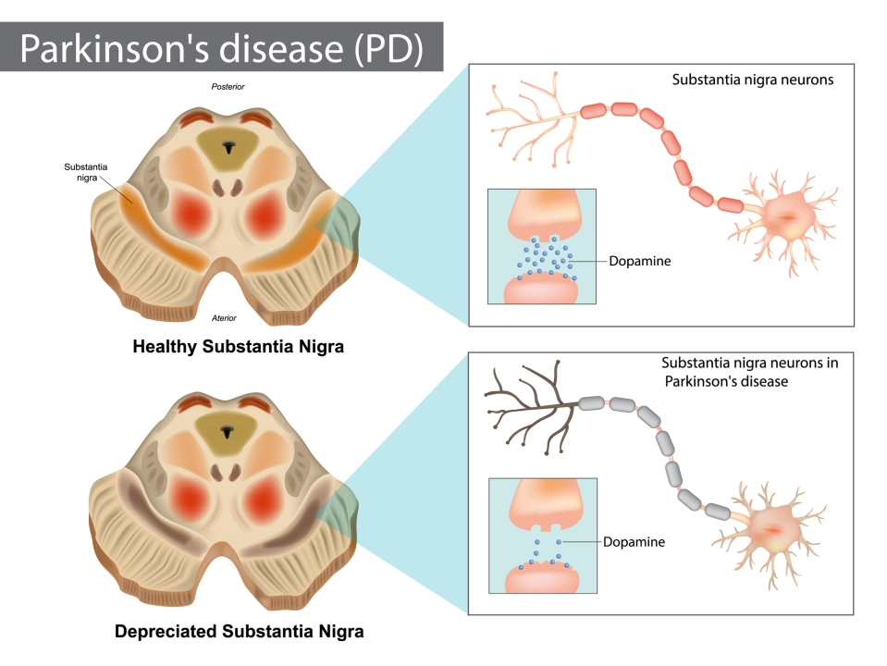
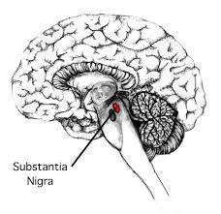
Dopaminergic neurons are lost in PD

Slide 5
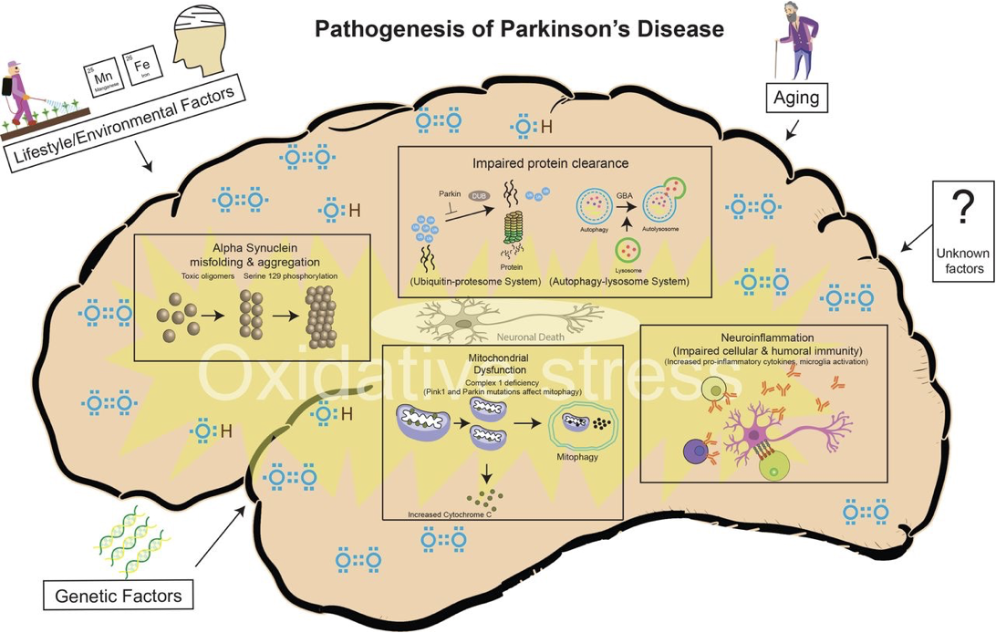
A combination of genetic and environmental factors confer risk for Parkinson’s disease

Slide 6
The question: What genes and cells drive PD?
Originally thought to be specifically associated with the loss of nigrostriatal dopaminergic neurons and deposition of α-synuclein (pathological proteins) in neurons.
Growing evidence implicating glial cell types, such as astrocytes and microglia
How do we study these different cell types?
Single-cell multi-omics simultaneously profiles gene expression and open chromatin from the same cell
DNA → RNA → protein
Gene expression: how much RNA
Chromatin accessibility: how open the DNA is to be transcribed

Slide 7
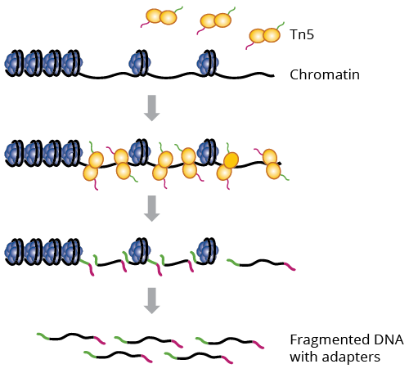
Chromatin Accessibility and Gene Expression
Tn5 binds to regions of open chromatin
Open chromatin indicates whether or not a gene may be transcribed
RNA measures the actual end-product of the transcription process

Slide 8
Goal: Implement machine learning techniques to identify disease-relevant cell markers

Slide 9
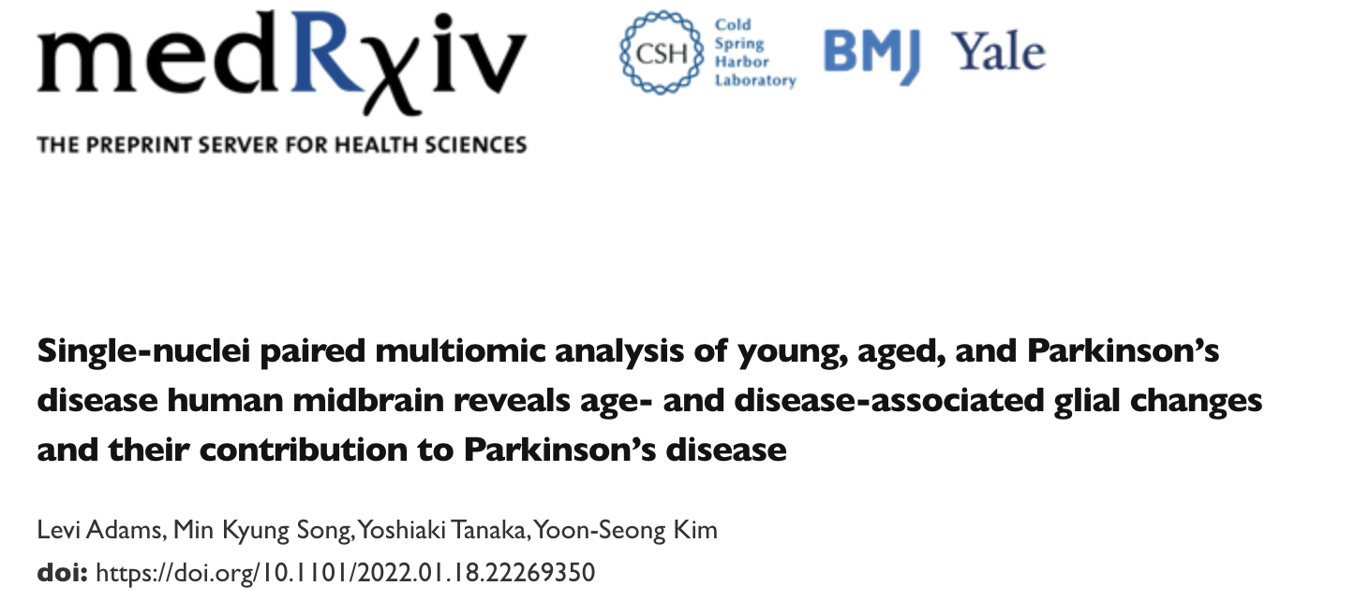
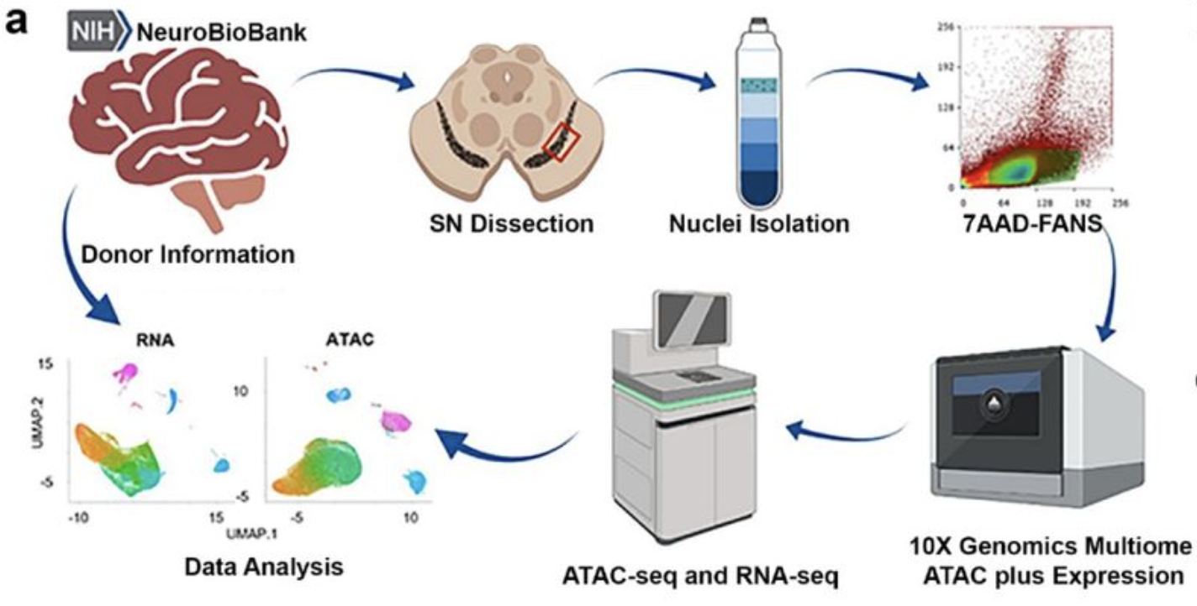
Dataset
69,289 nuclei with matched chromatin accessibility and gene expression data from 31 individuals
Substantia nigra samples from 9 young donors, 8 aged donors, 14 PD patients

Slide 10
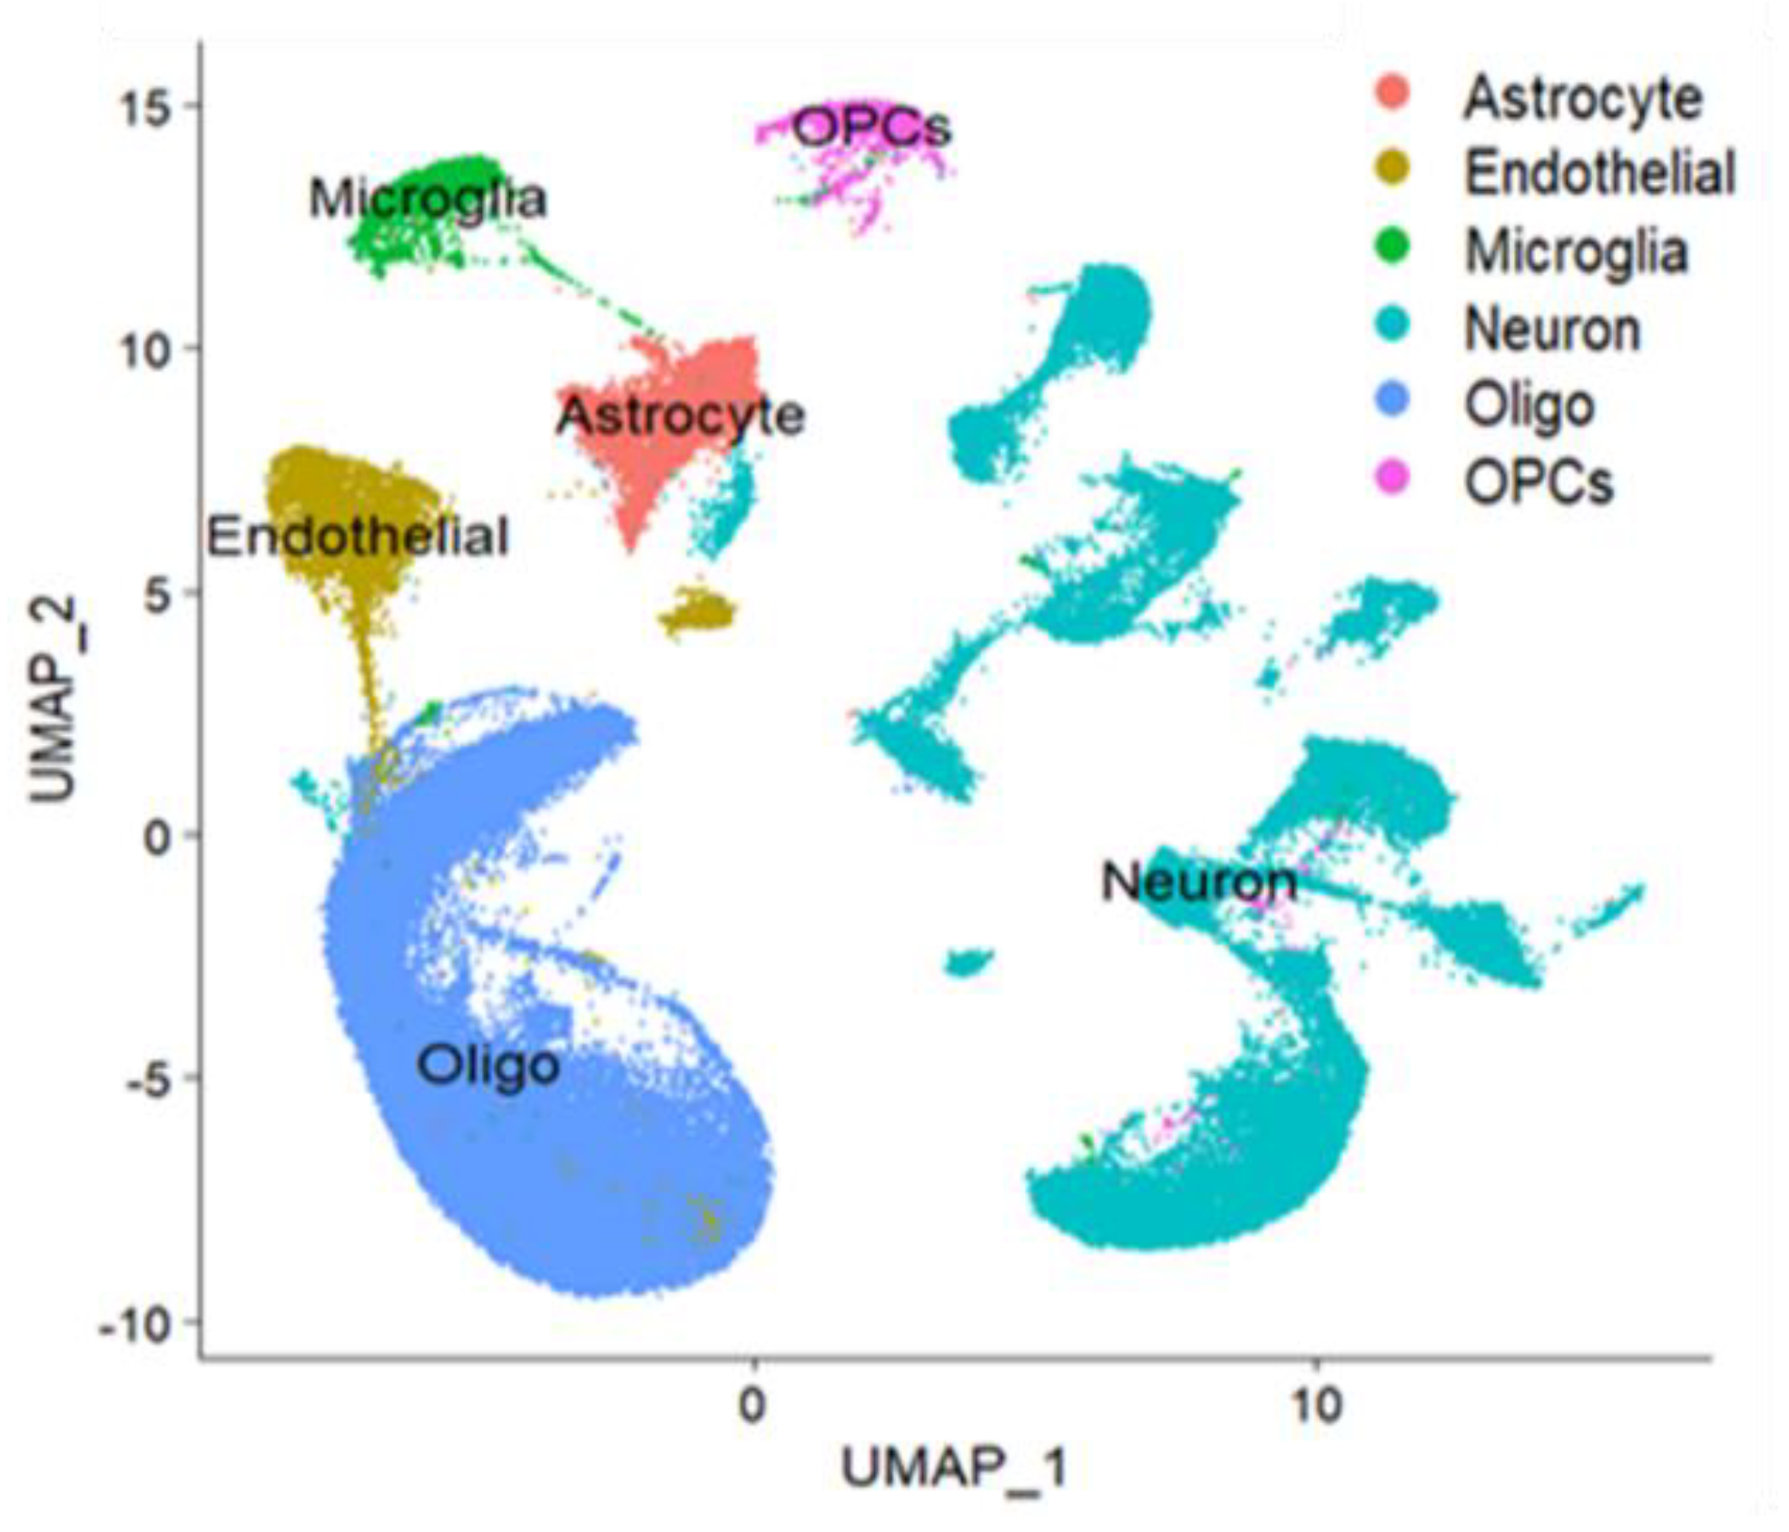
What will you do?
Data wrangling!
Learn how to work with single cell sequencing data and put it in the right format for analysis
Unsupervised learning
Can you develop methods to discover different cell types in the data?
Can you uncover any populations of cells or genes that look abnormal?
Supervised learning
Given a cell, can we predict whether it came from a healthy or PD sample?
What genetic patterns correspond with PD?
Challenge
How do you integrate data from two modalities (RNA and chromatin accessibility) to answer how a gene is functioning
Cells/Genes
SVM, ANN, Log-reg
PD or control

Slide 11
Thanks! Q/A?

